Slide 1
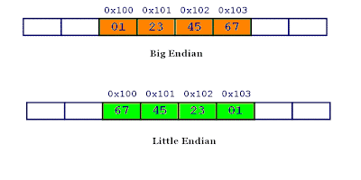
What are big and little endian?
Endianness is a term that describes the order in which a sequence of bytes is stored in computer memory. Endianness can be either big or small, with the adjectives referring to which value is stored first.
In little endian machines, last byte of binary representation of the multibyte data-type is stored first
On the other hand, in big endian machines, first byte of binary representation of the multibyte data-type is stored first.
A 4 bytes integer

Slide 2
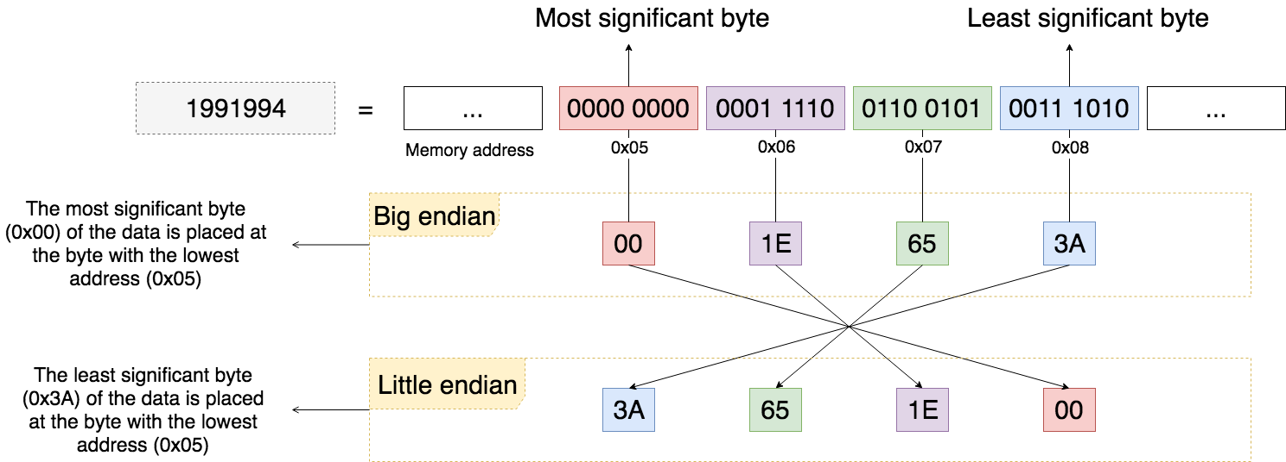

Slide 3
The advantages of Little Endian
It’s easy to read the value in a variety of type sizes. For example, the variable A = 0x13 in 64-bit value in memory at the address B will be 1300 0000 0000 0000. A will always be read as 13 regardless of using 8, 16, 32, 64-bit reads. By contrast, in Big Endian we have to know in which size we have written the value to read it correctly.
It’s easy to cast the value to a smaller type like from int16_t to int8_t since int8_t is the byte at the beginning of int16_t.
Easily to do mathematical computations “because of the 1:1 relationship between address offset and byte number (offset 0 is byte 0), multiple precision math routines are correspondingly easy to write.”

Slide 4
The advantages of Big Endian
We can always test whether the number is positive or negative by looking at the byte at offset zero, so it’s easy to do a comparison.
The numbers are also stored in the order in which they are printed out, so binary to decimal routines are particularly efficient.

